Slide 1

The Scholar's Toolkit: Reviewing Literature and Preparing Impactful Presentations
Dr. S. Angayarkanni
Professor
VIT Bangalore

Slide 2
"The journey of a thousand miles begins with a single step – and a thorough literature review."

Slide 3
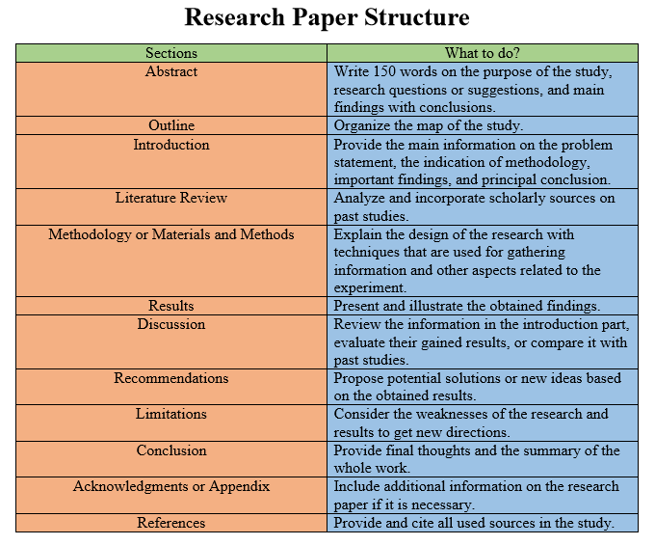
STRUCTURE OF RESEARCH PAPER

Slide 4
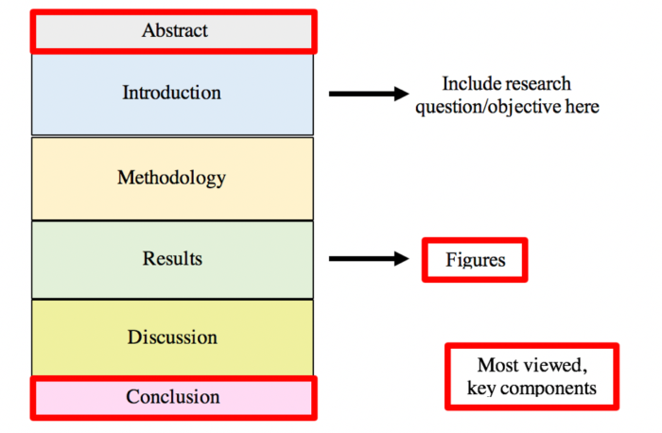

Slide 5
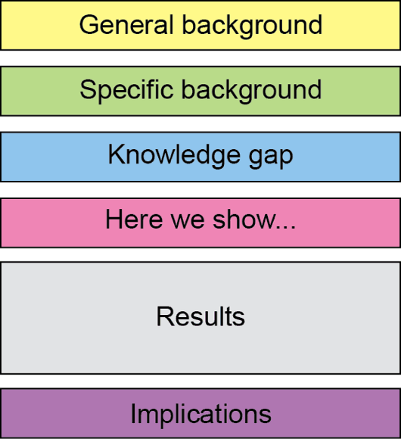
ABSTRACT

Slide 6
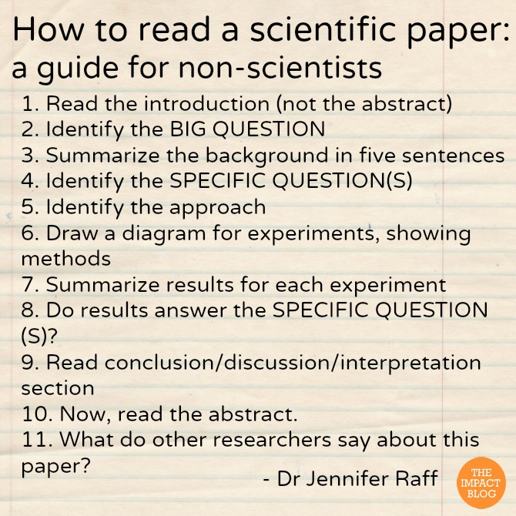

Slide 7
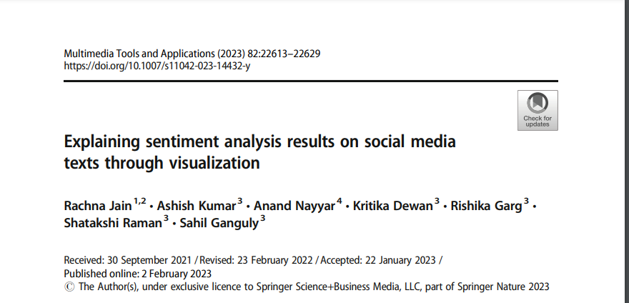
Sample paper

Slide 8


Slide 9
•Title: Gives you a general idea about the topic.
•Abstract: Provides a concise summary of the study's objective, methods, results, and conclusions.
•Conclusion: Helps you understand the primary outcomes of the research.
Preliminary Skim
•Ask yourself: This article address what type research question or contribute to the area of interest?
Determine Relevance

Slide 10
Background: Understand the context and significance of the study.
Objectives: Identify the main research question or hypothesis.
Read the Introduction
•Participants: Who were the subjects/dataset? How were they selected?
•Procedure: How was the research conducted?
•Tools & Measures: Were the instruments valid and reliable?
Examine the Methodology

Slide 11
Data Presentation: Review tables, figures, and graphs for key findings.
Statistical Analysis: Understand the main outcomes, significant differences, and correlations.
Understand the Results
Interpretation: How does the author interpret the results?
Comparison: How do the findings align or differ from previous research?
Implications: What does this mean for the field or real-world applications?
Limitations: What were the constraints or potential biases in the study?
Delve into the Discussion

Slide 12
Recap: Revisit the main findings and their significance.
Future Directions: What further research does the author suggest?
Reflect on the Conclusion
Citations: Familiarize yourself with foundational studies or major works cited.
Further Reading: References can lead you to other relevant articles.
Review References

Slide 13
9. Take Notes
Jot down key points, methodologies, findings, and your personal reflections or criticisms.
10. Discuss with Peers
Sharing insights and discussing interpretations can deepen your understanding.
11. Revisit if Necessary
It's okay not to grasp everything on the first read. Revisit sections that were challenging.
12. Stay Critical
Every study has limitations. Consider biases, the validity of conclusions, and the generalizability of findings.
13. Apply to Your Work
Reflect on how the findings can inform your research, studies, or professional practices.
14. Stay Updated
Research is continuous. New studies might confirm, expand, or contradict previous findings.

Slide 14
ONLINE RESOURCES – E JOURNALS
Open Access
Preprint Servers: Before articles are published in peer-reviewed journals, authors might upload them to preprint servers like arXiv, bioRxiv, or SocArXiv. These versions are not peer-reviewed but can provide early access to research findings.
ResearchGate
Google Scholar
Sci-Hub
Publisher's Website
https://www.mendeley.com/?interaction_required=true

Slide 15
Link to Open access Journal Page
https://www.elsevier.com/en-in/open-access/open-access-journals/search?meta_t=&query=&meta_s=Computer+Science#
https://www.springeropen.com/books;
https://link.springer.com/search?package=openaccess&facet-content-type=%22Book%22&utm_source=sn&utm_medium=referral_RM&utm_campaign=BBKK_1_CE02_GermanPagetoSL
https://open.ieee.org/
https://scholar.google.com/
https://sci-hub.se/
https://www.researchgate.net/
https://docs.lib.purdue.edu/cstech/?_ga=2.247716551.1353792408.1694691713-1691778508.1694691713
https://soda.la.psu.edu/research-papers/

Slide 16
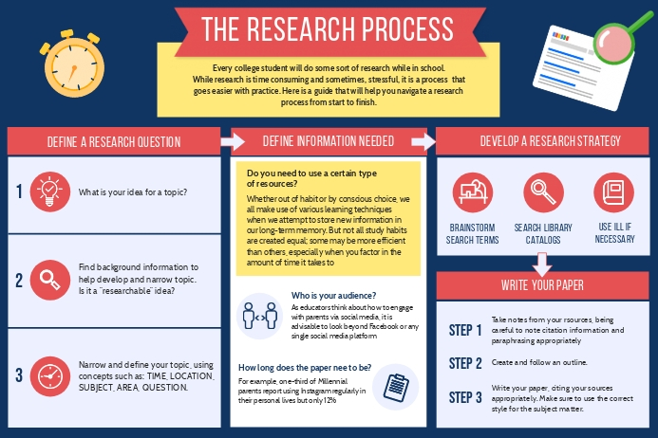

Slide 17
2 Minute Presentation Format
Slide 1: Title Slide
Title of the Research Article
Authors
Journal and Publication Date
Slide 2: Objective
Briefly state the main objective or purpose of the research.
Example: "This study aimed to determine the effects of X on Y.“
Slide 3: Background
Why is this research important?
What was previously known or what gap in knowledge does this address?

Slide 18
Slide 4: Methods (Brief)
Research design: Experimental, observational, qualitative, etc.
Key methods used.
Example: "Researchers conducted a double-blind randomized trial with 200 participants.“
Slide 5: Key Findings
1-3 most important results or findings.
Example: "X was found to significantly impact Y.“
Slide 6: Implications
Why do these findings matter?
How might they change our understanding or application in the field?
Slide 7: Conclusion
A brief summary statement about the research and its importance.

Slide 19
Slide 8: Questions (Optional)
This could be a slide prompting the audience for questions or further discussion, though given the brevity of the presentation, there might not be time for questions.

Slide 20
Tips for the Students:
Be Concise: With only 2 minutes, every second counts. Practice the presentation to ensure it fits within the time limit.
Visuals: Use visuals (graphs, images) to quickly convey complex information.
Avoid Jargon: Ensure the presentation is understandable to those who might not be familiar with the topic.
Engage the Audience: Start with a captivating fact or question to grab the audience's attention.
Practice: It's essential to practice the presentation multiple times to ensure clarity and coherence.

Slide 21
Dates
DATE | REVIEW DETAILS
NOV 12, 2024 | ABTSRACT & REVIEW
NOV 13, 2024 | ZEROTH REVIEW
NOV 22, 2024 | FIRST REVIEW
DEC 3, 2024 | SECOND REVIEW
DEC 9, 2024 | ROUGH DRAFT OF PROJECT REPORT
DEC 12, 2024 & DEC 13,2024 | FINAL REVIEW

